Slide 1
Selenium Grid
What is Selenium Grid?
Selenium Grid is a smart proxy server that makes it easy to run tests in parallel on multiple machines. This is done by routing commands to remote web browser instances, where one server acts as the hub. This hub routes test commands that are in JSON format to multiple registered Grid nodes.
Hub enables simultaneous execution of tests on multiple machines, managing different browsers centrally, instead of conducting different tests for each of them. Selenium Grid makes cross browser testing easy as a single test can be carried on multiple machines and browsers, all together, making it easy to analyze and compare the results.

Slide 2
Three major components of the Selenium Grid architecture are:
Standalone
Standalone combines all Grid components seamlessly into one. Running a Grid in Standalone mode gives you a fully functional Grid with a single command, within a single process. Standalone can only run on a single machine.
Standalone is also the easiest mode to spin up a Selenium Grid. By default, the server will listen for RemoteWebDriver requests on. By default, the server will detect the available drivers that it can use from the System PATH. http://localhost:4444
java -jar selenium-server-<version>.jar standalone
After starting successfully the Grid in Standalone mode, point your WebDriver tests to http://localhost:4444.
Hub is a server that accepts the access requests from the WebDriver client, routing the JSON test commands to the remote drives on nodes. It takes instructions from the client and executes them remotely on the various nodes in parallel
Node is a remote device that consists of a native OS and a remote WebDriver. It receives requests from the hub in the form of JSON test commands and executes them using WebDriver

Slide 3
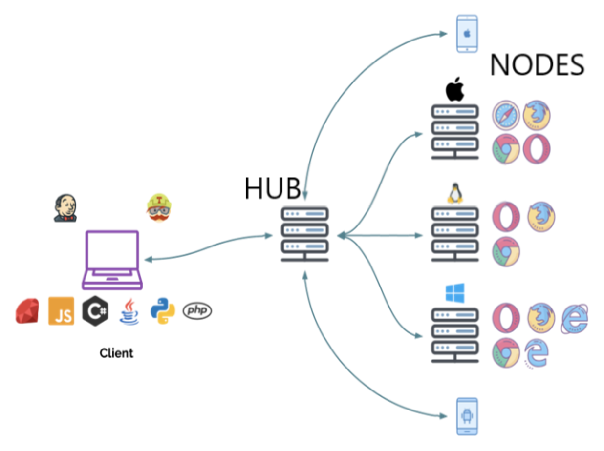
Selenium Grid Architecture -

Slide 4
When should testers use Selenium Grid?
Testers should use Selenium Grid in the following circumstances:
To run tests on multiple browsers and their versions, different devices, and operating systems
To reduce the time that a test suite takes to complete execution
Selenium Grid improves the turnaround time of the test results. It is especially useful when the test suite is large and takes more time to run. It offers flexibility and ensures maximum test coverage within a limited time. Since the virtual infrastructure is in use, maintenance becomes easy.

Slide 5
How to setup Selenium Grid for Cross Browser Testing
Selenium Grid can be used to perform Cross Browser Testing at a scale, by running a test on different browser-device combinations simultaneously. Using parallel testing, you can ensure a consistent user experience across various browser versions and devices in a short period of time.
To perform cross browser testing using Selenium Grid, follow the steps below for Selenium Grid configuration:
Step 1: Installation
Before getting started, download the Selenium Server Standalone package. This package is a jar file, which includes the Hub, WebDriver, and legacy RC that is needed to run the Grid. To get started with Selenium Grid, it is essential to have Java already installed, and set up the environment variables.

Slide 6
Step 2: Start Hub
Hub is the central point in the Selenium Grid that routes the JSON test commands to the nodes. It receives test requests from the client and routes them to the required nodes. To set up the Selenium Hub, open the command prompt, and navigate to the directory where the Selenium Server Standalone jar file is stored (downloaded in Step 1) using the following command.
java -jar selenium-server-standalone-<version>.jar -role hub
This will start the Hub automatically using port 4444 by default. Testers can change the default port by adding an optional parameter port, using
-host <IP | hostname>

Slide 7
To view the status of the hub, open a browser window and navigate to https://localhost:4444/grid/console
Step 3: Start Nodes
Whether testers are looking to running a grid with new WebDriver functionality or with the Selenium 1 RC functionality or running both of them simultaneously, testers have to use the same Selenium Server Standalone jar file, to start the nodes. To start nodes open the command prompt and navigate to the directory, where the Selenium Server Standalone jar file is stored.
Type the following command
java -jar selenium-server-standalone-<version>.jar -role node -hub https://localhost:4444/grid/register

Slide 8
When -role option that is provided is not specified, and it is not the hub, the default port is 5555. So, it is important to define the -role to be a node in this case.

